Slide 1
What you need to know about the Math Stack
MathML, MathJax, HTML5, and EPUB 3

Slide 2
Introduction
Autumn Cuellar, Associate Product Manager
Design Science
MathType
MathFlow
MathPlayer
MathDaisy
Equation Editor
Notes:
Give a little of the history of Design Science, mention work in standards communities

Slide 3
Overview
Exciting new standards developments:
MathML 3
HTML5
EPUB 3
Filling the gaps: MathJax
So why all the fuss about MathML?
I want to go there. But how?
Conclusion

Slide 4
MathML
The XML standard for encoding mathematics
MathML 1 spec finalized in 1998
MathML 2 in 2003
MathML 3 in late 2010
Notes:
By now I’m sure you’ve heard of MathML.
MathML 2 was MathML’s coming of age. It corrected many of the basic problems in MathML 1. For example, there was no way to specify a line break in MathML 1 without the use of tables.

Slide 5
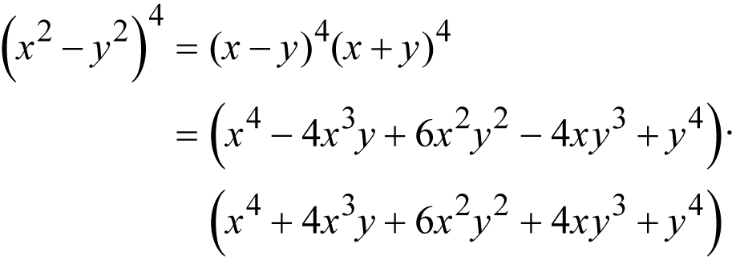
MathML 3
Line wrapping and line breaking
Notes:
With MathML 3, MathML has reached a new maturity. With this latest version, the working group carefully considered the requirements of the publishing community, and to meet those needs, they established new facilities for line wrapping and line breaking. These include aligning new lines against the first line (such as aligning by the equals sign), specifying a multiplication character to use if the break is between expressions such that the multiplication is implied (for example, here we use a dot multiplication character), and the width of a column so that breaks are automatically inserted into the equation.

Slide 6
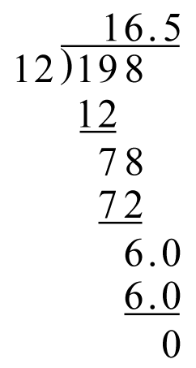
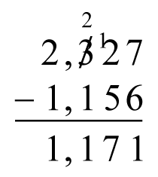
MathML 3
Elementary math
Notes:
MathML 3 also adds elementary math notation for the education sector. For example, to specify carries and cross-outs in stacked operations; long division; and repeating decimals

Slide 7
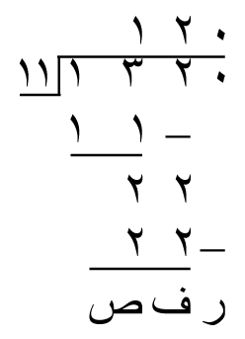
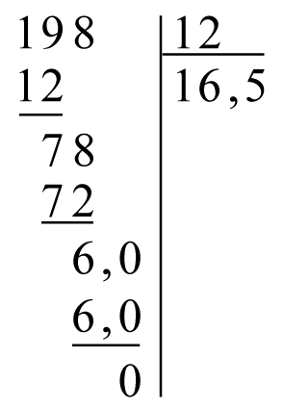
MathML 3
International math support
Notes:
And finally, for those of us who want to localize our content, MathML now provides international support, from right-to-left language support to support for alternative notations.

Slide 8
HTML5
World Wide Web - by scientists for scientists…
But HTML, the primary web language, had no support for math…
Until HTML5
Notes:
While MathML has gone through its maturation process, it has slowly but surely been gaining steam as a worthy format for encoding mathematics. Math is the poor neglected stepchild always, isn’t it? Admit it! Math is the last thing that any of us wants to think about, but to our everlasting consternation, it’s not going away. And it’s the same for standards communities. The Internet was built by scientists for scientists, but HTML, the language behind the World Wide Web, had no built-in support for math until about 6 months ago, when HTML 5 was finalized with MathML included, because the HTML working group finally realized what we’ve known all along – math, for better or worse, is here to stay.

Slide 9
HTML5
Browser makers have been vocal in their support of HTML5
Already some MathML support:
Gecko – Mozilla/Firefox
Webkit – Safari
Opera (through CSS)
Notes:
So the great news is that MathML support is on its way!

Slide 10
EPUB 3
EPUB 2: DAISY and XHTML
DAISY included MathML…
… so IDPF was not so far behind on the math curve.
Or were they?
EPUB = XHTML
Notes:
EPUB 2 included two content formats for ebooks: DAISY and XHTML. DAISY is an independently managed standard for specifying Digital Talking Books, mostly used for accessibility purposes.

Slide 11
EPUB 3
EPUB 3 in December 2011
“exciting new format … set to unleash a content revolution in the publishing world” – Matt Garrish
“The future of e-books is now.” – Digital Book World

Slide 12
EPUB 3
Built on HTML 5
eReaders built on browsers may already support MathML!
Example, iBooks
Notes:
Not to confuse, but iBooks supports MathML, but it’s only EPUB 2 compliant. It doesn’t support EPUB 3 yet.

Slide 13
Filling the Gap
MathML support is growing!
But still lots of gaps
Safari, Opera – support not great
Chrome and IE – no native support
No content producer likes gaps
Luckily, there’s MathJax
Notes:
Let’s be honest, we don’t like gaps. No one wants to produce content such that our audience has to jump through hoops to get to it! Because we all know how infuriating it is to visit a website and see a message like, “This website requires Firefox version 13 or later” when you’re not on Firefox version 13 or later.

Slide 14
MathJax
Managed by a consortium including American Mathematical Society and Society for Industrial and Applied Mathematics
Open-source Javascript library for rendering MathML in any modern browser.
Notes:
Managed by a consortium that was once headed by us, Design Science, but we’ve since handed over the reins to the American Mathematical Society. It’s sponsored by AIP, IEEE, Cengage Learning, Elsevier, and Stack Exchange.

Slide 15
MathJax
Chrome, IE, Safari, Firefox, etc.
Mobile devices, laptops, PCs
Wider range of eReaders, including Calibre and Readium (demo)
Notes:
MathJax.org keeps a list of eReaders that support MathML and how they do so (show screenshot).

Slide 16
Why MathML?
For the same reasons we get excited about HTML5 and EPUB 3:
We can do more with what we have…
Notes:
I can tell you’re a bit underwhelmed. Wow. Formulas. On a screen. Woo. Listen, Autumn. We can already do that. It’s called an image. Or TeX. Or ASCII. I know! There are other ways to show an equation on a screen.
With HTML 5 and EPUB 3 we are excited about embedding media in our pages. With EPUB 3, you can add video footage to history books, current poll data to travel books, a music clip to a book that references the lyrics to a song, and so on and so forth. It’s all about enriching the content. Doing more with what we have. Same for math by using MathML.

Slide 17
Searchability
Information Age
Search is key to navigating through all of that information
Math search on the horizon
Projects showing success use MathML:
MathDex
EgoMath
MathWebSearch
Notes:
http://www.emc.com/about/news/press/2012/20121211-01.htm
Every year EMC, makers of storage and big data systems, puts out a study called the Digital Universe Study, measuring the amount of digital data available. By the end of 2012, they measured 2.5 Zettabytes of data available worldwide. The amount of data had doubled in 2 years. One zettabyte is 1 trillion gigabytes.
A holy grail in the field of mathematics is how best to search math because as some of you know, math is at the heart of almost all processes. And there is some idea that if you can search across multiple disciplines for a formula at the heart of a process, you might be able to adapt a process from a more well-known area to a less-known area. For example, using formulas derived from animal migration movements to traffic patterns.

Slide 18
Localization
Notes:
While math is a universal language, and semantically one expression might be the same as the next, the notation to express a given equation might vary from region to region. If you plan to localize your content, you can use stylesheets to target your math to your audience.

Slide 19
Flexibility
Easily target a range of devices:
Mobile devices
PCs
Retina display
Stylesheets give you power over presentation

Slide 20
Accessibility
The accessibility community favors MathML – NIMAS, DAISY, others
Through MathPlayer, several screen readers and Braille translation tools support MathML (demo)
Notes:
You may be required by government statute to support readers with vision/learning disabilities, and even if you don’t have to meet government regulations, why limit your audience?

Slide 21
Interoperability
Wide support of MathML in applications:
CAS
Graphing
Calculators
Assessment creators
Whiteboards
Etc.
(demo)

Slide 22
How to Get There
Doctypes (Docbook, DITA)
MathML Editors (MathFlow)
Conversion processes (XSLT)
MathJax

Slide 23
Conclusion
HTML5 and EPUB 3 have matured to the point of supporting MathML 3
Browsers and eReaders are catching up
MathJax is filling the gap ‘til they do
This is great because MathML offers exciting avenues for math content!
We can help you take advantage

Slide 24
Design Science
www.dessci.com

